Slide 1
Body temperature
Dr. Wafa Mubarak

Slide 2
Human body has a thermoregulatory mechanisms that regulate his body tempreture

Slide 3
Regulation of body temperature
Various parts of the body are at different temperatures.
the temperature difference between body parts varies with the environmental temperature
The limbs are cooler than the rest of the body.

Slide 4
Normal body temperature = 37+ or – 0.5 ºC.
(98.6 °F)
core temperature varies little with enviromental temperature.
lowest in mornings and highest in the evenings

Slide 5
Blood serves as the major agent of heat transfer between the core and skin
Core temperature remains relatively constant, while skin temperature fluctuates substantially
(20°C–40°C)

Slide 6
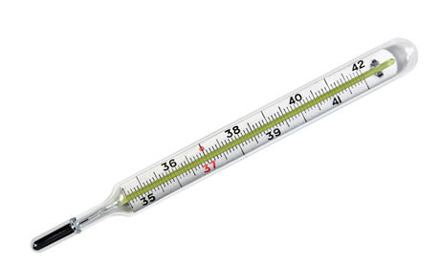
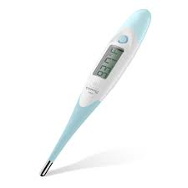
Core temperature can be measured by thermometer from
1- Rectum
The rectal temperature is representative of the temperature at the core of the body
varies little with changes in environmental temperature.

Slide 7
2- Mouth
Oral temperature averaged 36.7 °C.
is normally 0.5 °C lower than the rectal temperature.
is affected by many factors.
ingestion of hot or cold fluids, gum-chewing, smoking, and mouth breathing.

Slide 8
Core temperature
Affected by:
Age
sex
Physical activity (exercise ,anxious ,relaxed ,sleep)
Hormones (progesterone- ovulation ,thyroid Hormones)
Emotional state (tensing of muscles).
The core temperature has a regular circadian fluctuation of 0.5–0.7 °C.

Slide 9
Regulation of body temperature
Heat balance: Heat gain=Heat loss.
Heat gain by:
Basic metabolic processes (BMR).
Food intake
Muscular activity (voluntary or involuntary).
As our bodies is hotter than environment
Heat loss mainly occurs by:
Conduction
Convection.
Radiation.
Evaporation of sweating.

Slide 10
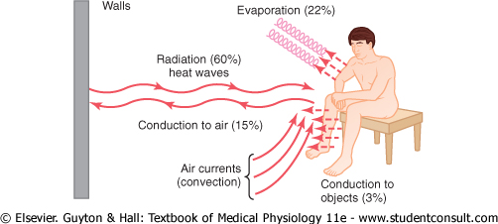

Slide 11
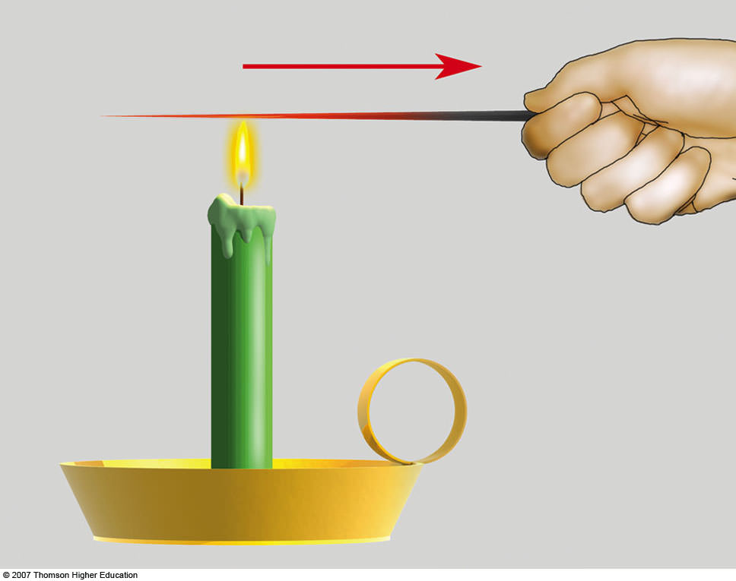
Conduction
is heat exchange between objects or substances at different temp. that are in contact with one to another

Slide 12
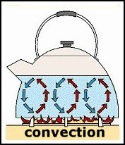
Convection
the movement of molecules away from the area of contact by successive currents of air or water.

Slide 13
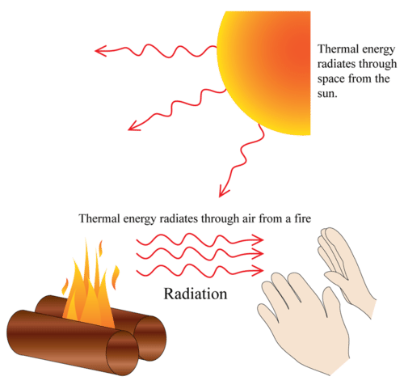
Radiation
is the transfer of heat by infrared electro –magnetic radiation from object to another at a different temper- which it is not in contact

Slide 14
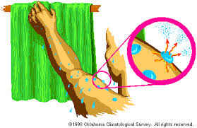
Evaporation
Evaporization of water on the skin(sweat) and mucous membranes of the mouth and respiratory passages
The degree of sweat vaporizes depends on the humidity of the environment

Slide 15
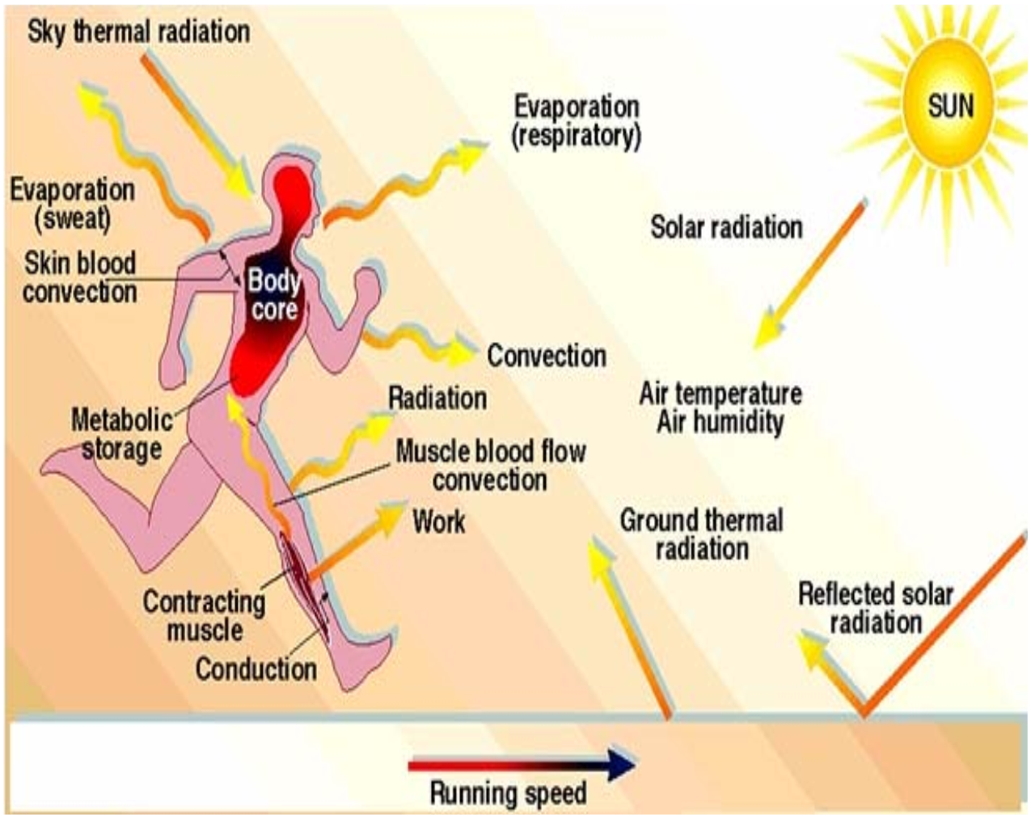

Slide 16
Sweat
Sweating rate is regulated by thermoreg-ulatory mechanisms.
When sweat secretion is increased, the degree to which the sweat vaporizes depends on the humidity of the environment.

Slide 17
Temperature regulating mechanisms
Reflex thermoregulatory responses.
Receptors: cold and warm receptors in skin and hypothalamus.
Control center: hypothalamus adjusts the set point of core tempreture.
Effectors: sweat glands, skeletal muscles, blood vessels of skin.

Slide 18
The reguation of body temperature is essential for life because its disturbance affect:
1- Enzymes activity
2- speed of biochemical reactions.
3- activity of body systems, espcially the nevous system .

Slide 19
Body response to cold exposure
Posterior hypothalamus is the center
The thermoregulatory mechanisms act to:
1- Increase heat production (gain).
2- Decrease heat loss.

Slide 20
1- Increase heat production:
  Shivering
  Hunger
  Increased voluntary activity
  Endocrine :increased Epinephrine & Norepinephrine.

Slide 21
Shivering Vs muscular exercise
1- shivering is irregular involuntary skeletal muscle contractins.
2- starts when the body tempreture decreases.
3- maximum shivering increases heat production 4 to 6 times the resting level.

Slide 22
2- Decrease heat loss by:
  Cutaneous vasoconstriction.
  Curling up
  Horripilation

Slide 23
Body response to heat exposure
Anterior hypothalamus is the center
The thermoregulatory mechanisms act to:
1- Increase heat loss.
  Cutaneous vasodilatation.
  Sweating.
  Increased respiration.

Slide 24
2- Decrease heat production (gain).
  Anorexia (loss of appetite).
  Inertia (decreased voluntary activity)

Slide 25
Fever
Rise in body temperature due to pathological cause.
Mechanism (pathogenesis):
Bacterial toxins and inflammatory mediators affect the hypothalamus raise set point leading to Fever

Slide 26
Fever has benifits
1- decrease the microorganisms growth.
2- increase the rate of antibodies.
3- is a sign of many disease .
But
If the rectal temperature over 41 °C
(106 °F) for long period rsult in some brain damage.

Slide 27
Heat Stroke
Failure of sweating in hot dry enviroment.
Elevation of body temperature above 43 °C. Causes convulsions and coma and might lead to death.
The thermoregulatory center is damaged.

Slide 28
Heat Exhaution
Sweat fails to evaporate in hot humid env-iroment.
So there is excessive sweating, but dose not evaporate.
Core temprature elevates.
Patint develop dehydration, hypotention, shock.

Slide 29
Heat-loss mechanisms are fully functional
If not treated, patient will develop heat stroke
Give him IV fluids in fanned cold room

Slide 30
Hypothermia
Is a medical emergency that occurs when your body loses heat faster than it can produce heat, causing a dangerously low body temperature.

Slide 31
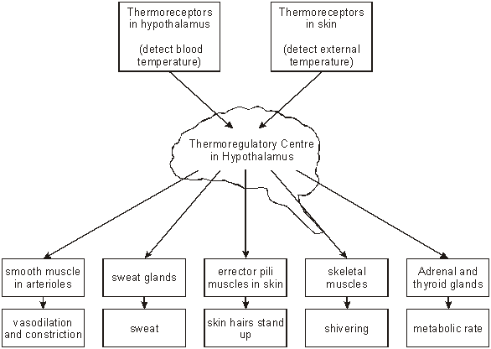
Homeostatic control

Slide 32


